Slide 1



Molten Salt Energy Carrier Model Informed by the Pair Distribution Function
Isaac Walker, Jacob Numbers, Tyler Hamm, Anthony Birri, Nick Termini, Troy Munro
ihwalker@byu.edu
Notes:
Introduce yourself as a junior (right?) research assistant in my lab working on this project with Jake Numbers (the MS student over the project). Tony and Nick are from Oak Ridge and were Jake’s mentors during his internship

Slide 2
Presentation Outline
Molten Salt Thermal Conductivity
Results
Previous Predictive Models
Model of Energy Carriers
Conclusion
Notes:
Enter speaker notes here.

Slide 3
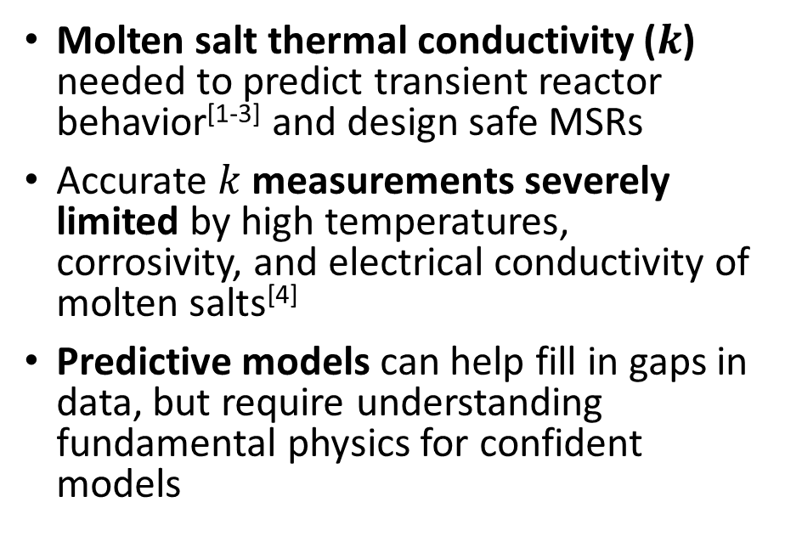
Foundational Challenges
Licensed MSRs
Competitive energy cost
Molten salt thermal conductivity ($k$) needed to predict transient reactor behavior^{[1-3]} and design safe MSRs
Accurate $k$ measurements severely limited by high temperatures, corrosivity, and electrical conductivity of molten salts^{[4]}
Predictive models can help fill in gaps in data, but require understanding fundamental physics for confident models
Experimental Data
Accurate reactor modeling
Optimized MSR design
Predictive Models
Fundamental Physics
Data to validate connection between model and physics
Notes:
Enter speaker notes here.

Slide 4
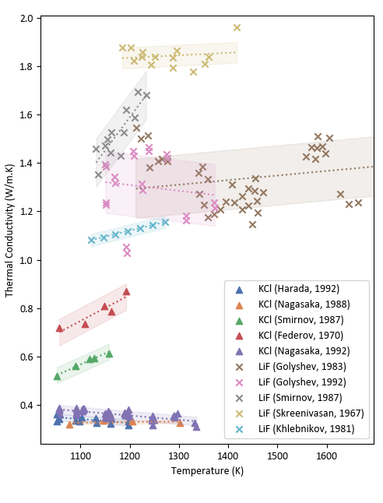


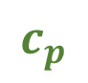

Foundational Challenges (Molten Salt Thermal Properties Database - Thermophysical Properties, MSTDB-TP)
LiF
5 actinide-bearing salts
26 thermal conductivity measurements
18%
12%
9%
KCl
4%
820 salt compositions in MSTDB-TP^{[4]}
$$ρ$$
$$ν$$
$$k$$
$$c_{p}$$
Notes:
$ρ$ = density
$ν$ = viscosity
$k$ = thermal conductivity
$c_{p}$ = specific heat

Slide 5
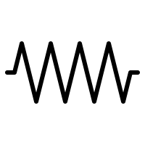
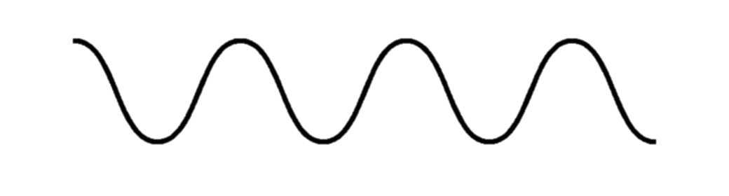
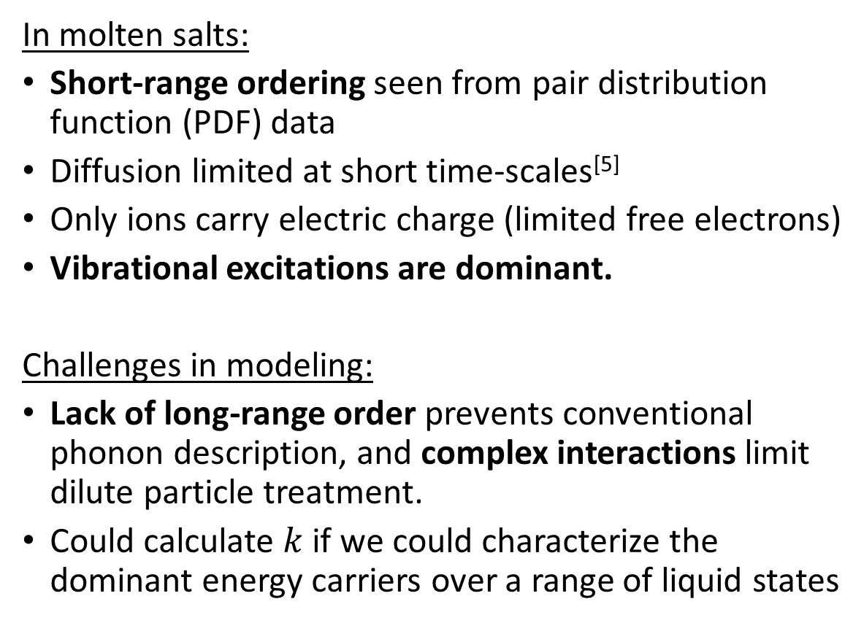
Liquid Thermal Conductivity
Kinetic Theory of Gases
Dilute system – limited intermolecular interactions
Energy stored in individual molecules
Transferal rate via collisions proportional to molecular MFP
In molten salts:
Short-range ordering seen from pair distribution function (PDF) data
Diffusion limited at short time-scales^{[5]}
Only ions carry electric charge (limited free electrons)
Vibrational excitations are dominant.
Challenges in modeling:
Lack of long-range order prevents conventional phonon description, and complex interactions limit dilute particle treatment.
Could calculate $k$ if we could characterize the dominant energy carriers over a range of liquid states
Energy Transfer in Ionic Liquids?
Phonon Physics of Solids
Significant interactions between molecules
Energy stored in vibrational modes in structure
Energy transferal rate proportional to excitation MFP
Notes:
Enter speaker notes here.

Slide 6
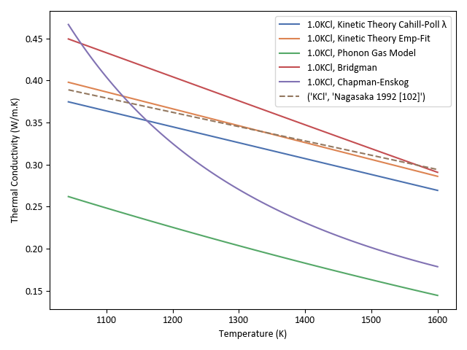
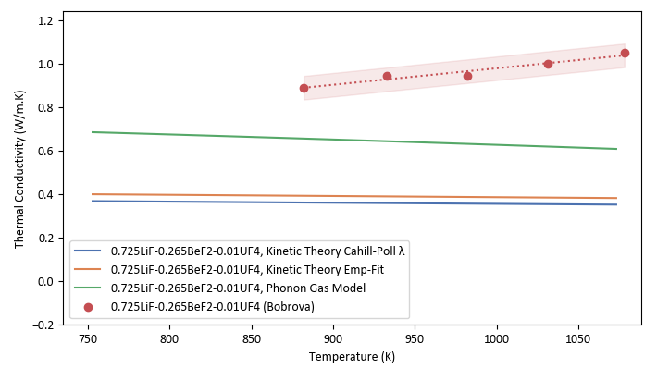
Previous Model Analysis
KCl
Exp
Exp
Zhao – Phonon Gas Model
Gheribi – Kinetic Theory
Assumes that mean free path is approximated by average interatomic distance—causes under-estimations of nearly all salts, but better with actinides
Large ion mass disparity and complexation factor causes significant error in the case of actinides.
Actinide-bearing
We propose a generalized energy carrier model based on the pair distribution function (PDF)
Notes:
In Zhao’s phonon gas model –
Strengths
Assumes bulk volumetric properties approximate phonon characteristics per unit volume, conceptually links measured c_{p} and v_{s} to energy carriers.
Weaknesses
Assumes that mean free path is approximated by average interatomic distance—causes underestimations of nearly all salts
For Gheribi’s Kinetic Theory
Strengths
Temp-dependent adjustment based on thermodynamic link between thermal expansivity and k.
Latest iteration of Gheribi’s kinetic theory accounts for damping to conductivity caused by complexes
Weaknesses
Large ion mass disparity causes significant error due to mass fluctuation term in the case of actinides.
Complexation factor further reduces k for actinide-bearing salts

Slide 7
New PDF-informed Thermal Conductivity Model

Slide 8
Energy Carriers

Slide 9
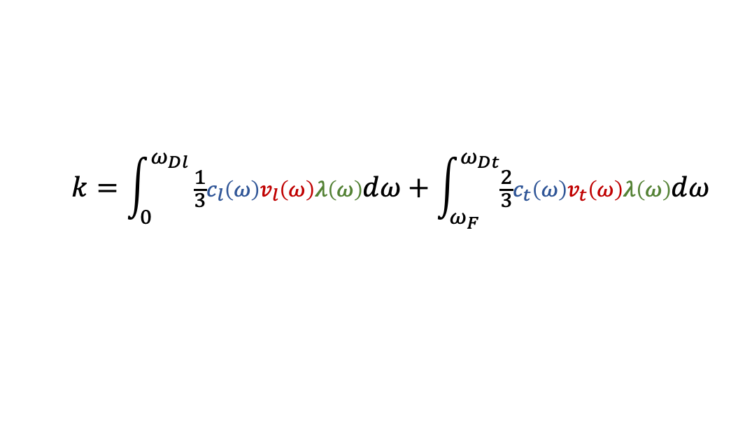
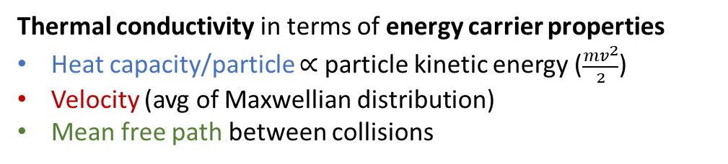
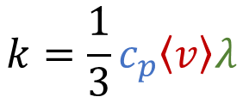
Energy Carriers in a Coherent Medium
Analogy to General Energy Carriers
Thermal conductivity in terms of energy carrier properties
Heat capacity/particle $∝$ particle kinetic energy ($\frac{{mv}^{2}}{2}$)
Velocity (avg of Maxwellian distribution)
Mean free path between collisions
$$k=\frac{1}{3}c_{p}\left\langle v\right\rangle λ$$
Scattering
Increasing temperature
2 transverse phonon modes (generally negligible in liquids, high Frenkel frequency)^{[17]}
1 longitudinal phonon mode
$$k=\int_{0}^{ω_{Dl}}{\frac{1}{3}c_{l}\left(ω\right)v_{l}\left(ω\right)λ\left(ω\right)dω+\int_{ω_{F}}^{ω_{Dt}}{\frac{2}{3}c_{t}\left(ω\right)v_{t}\left(ω\right)λ\left(ω\right)dω }}$$
But in liquids, there is a variable phase space^{[16]}, i.e. as temperature increases, viscosity/diffusion limits phonon wavelengths

Slide 10
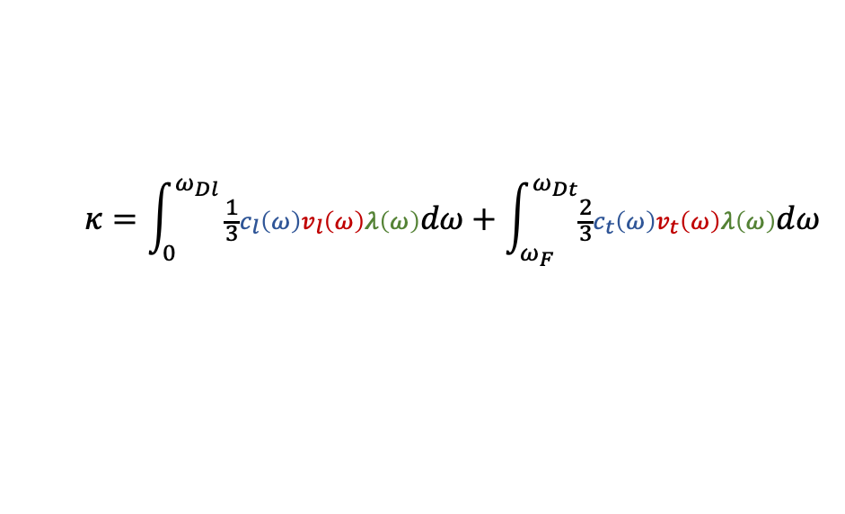
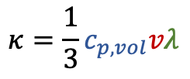
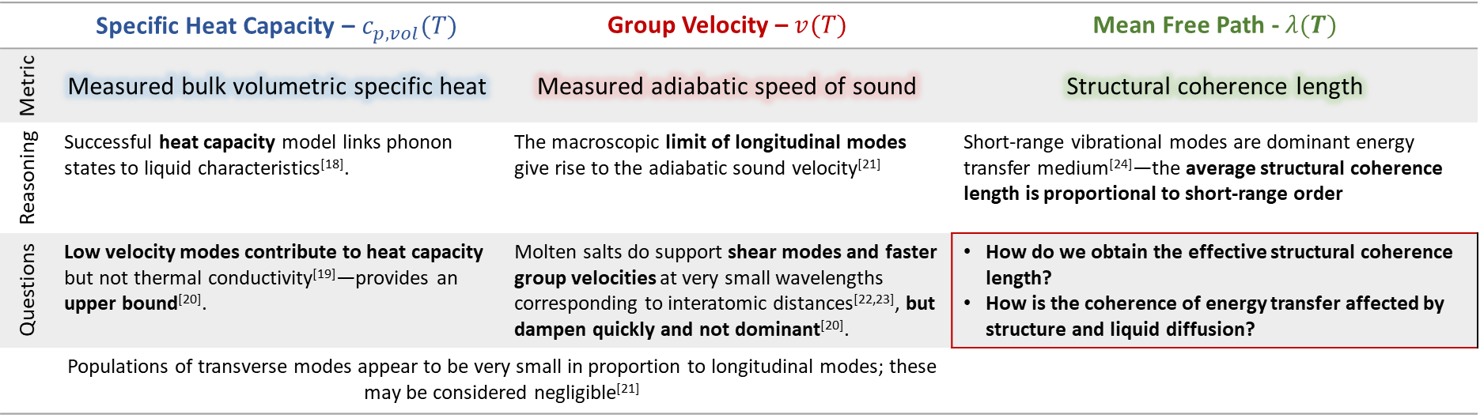
2 transverse phonon modes (generally negligible in liquids, high Frenkel frequency)
Properties—Macro to Micro
1 longitudinal phonon mode
Characterizing Energy Carriers
$$κ=\int_{0}^{ω_{Dl}}{\frac{1}{3}c_{l}\left(ω\right)v_{l}\left(ω\right)λ\left(ω\right)dω+\int_{ω_{F}}^{ω_{Dt}}{\frac{2}{3}c_{t}\left(ω\right)v_{t}\left(ω\right)λ\left(ω\right)dω }}$$
What temperature and composition-dependent, measurable parameters characterize the dominant energy carriers?
$$κ=\frac{1}{3}c_{p,vol}vλ$$
Assuming effective properties of energy carriers, neglecting transverse modes
 | Specific Heat Capacity – $c_{p,vol}(T)$ | Group Velocity – $v(T)$ | Mean Free Path - $λ(T)$
Metric | Measured bulk volumetric specific heat | Measured adiabatic speed of sound | Structural coherence length
Reasoning | Successful heat capacity model links phonon states to liquid characteristics^{[18]}. | The macroscopic limit of longitudinal modes give rise to the adiabatic sound velocity^{[21]} | Short-range vibrational modes are dominant energy transfer medium^{[24]}—the average structural coherence length is proportional to short-range order
Questions | Low velocity modes contribute to heat capacity but not thermal conductivity^{[19]}—provides an upper bound^{[20]}. | Molten salts do support shear modes and faster group velocities at very small wavelengths corresponding to interatomic distances^{[22,23]}, but dampen quickly and not dominant^{[20]}. | How do we obtain the effective structural coherence length? How is the coherence of energy transfer affected by structure and liquid diffusion?
 | Populations of transverse modes appear to be very small in proportion to longitudinal modes; these may be considered negligible^{[21]}

Slide 11
Pair Distribution Function (PDF) - Derived parameters in model

Slide 12
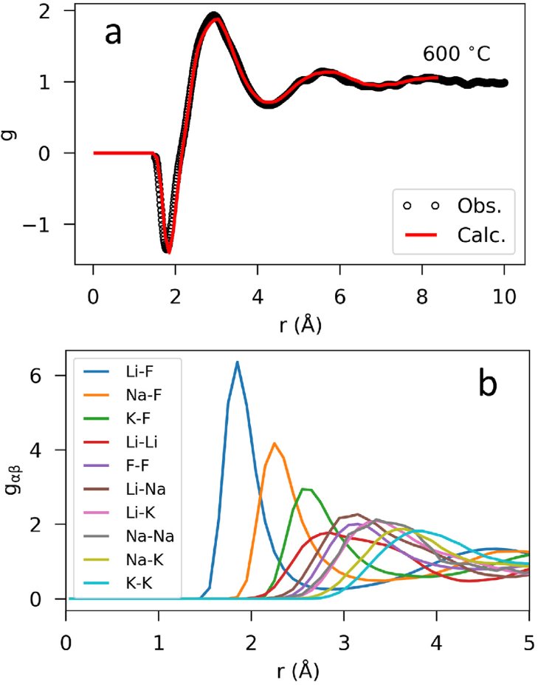
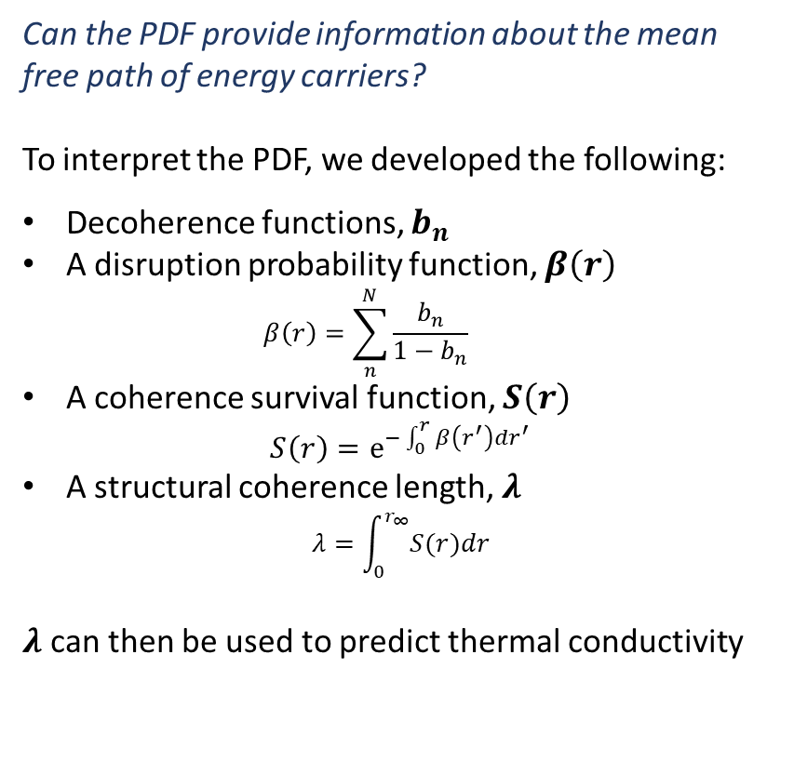
Pair Distribution Function
Molten FLiNaK.
a) Experimental PDF
b) Modeled partial PDF ^{[25]}
Short Range Liquid Structure
Can the PDF provide information about the mean free path of energy carriers?
To interpret the PDF, we developed the following:
Decoherence functions, $b_{n}$
A disruption probability function, $β\left(r\right)$
$$β\left(r\right)=\sum_{n}^{N}{\frac{b_{n}}{1−b_{n}}}$$
A coherence survival function, $S\left(r\right)$
$$S\left(r\right)=e^{−\int_{0}^{r}{β\left(r^{′}\right)dr^{′}}}$$
A structural coherence length, $λ$
$$λ=\int_{0}^{r_{∞}}{S(r)dr}$$
$λ$ can then be used to predict thermal conductivity

Slide 13
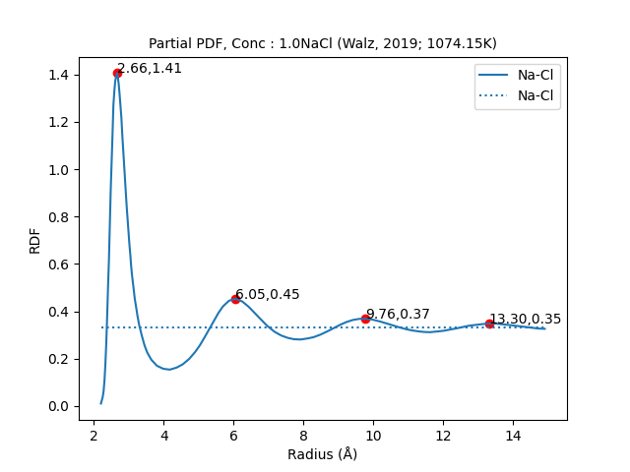
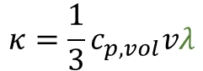
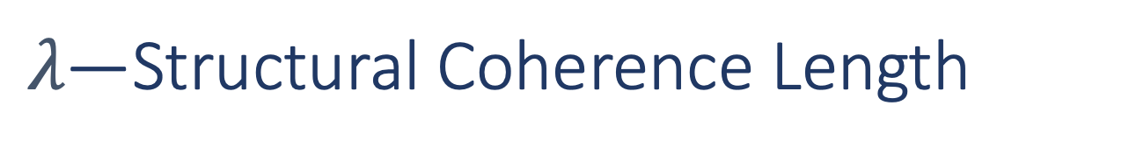
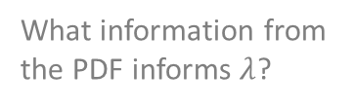
$λ\text{—}$Structural Coherence Length
Interpreting the Pair Distribution Function
Thermal energy transferred
Assumptions:
Cation-anion pairs are the dominant medium in energy transfer (strongest bonds, charge-ordering).
Energy carriers (phonons, sequential ion collisions, etc.) will propagate as long as its medium remains coherent.
Structural coherence length is proportional to the degree of short-range order in molten salts.
Energy must be redistributed wherever structural coherence ends
Bulk number density
Some portion continues to the extent of a coherent medium
Concentration of ion pair
Perfect decay function fitting indicates that mechanisms for coherence decay in first coordination shell continue with r.
How does coherence change with distance?
$$κ=\frac{1}{3}c_{p,vol}vλ$$
What information from the PDF informs $λ$?

Slide 14
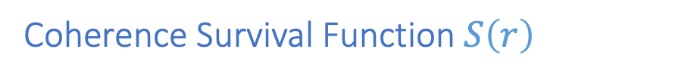

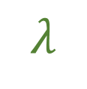
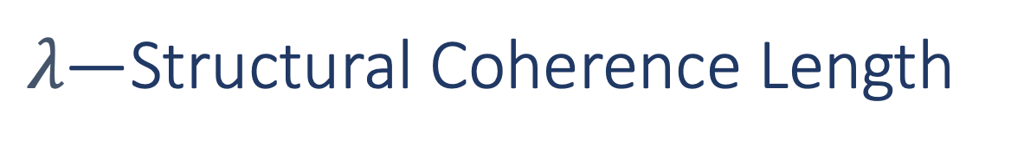

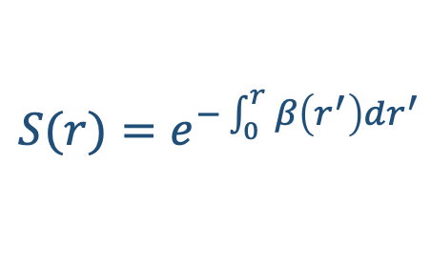
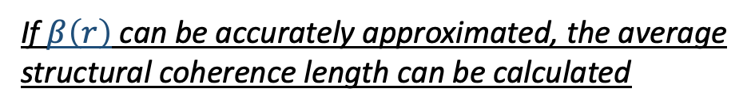
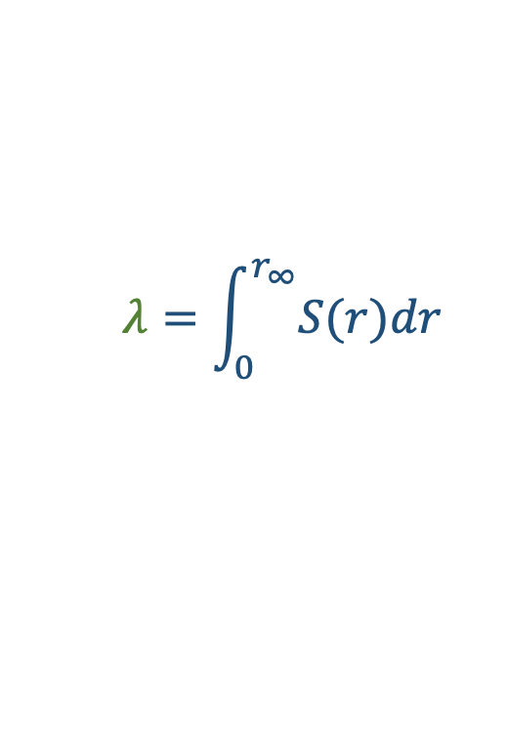

$λ\text{—}$Structural Coherence Length
Coherence Survival Function $S\left(r\right)$
g(r)
1
$$S(r)=e^{−\int_{0}^{r}{β\left(r^{′}\right)dr^{′}}}$$
Area under normalized cumulative survival function is the average distance of energy transfer—the average structural coherence length
r
S(r)
$$λ=\int_{0}^{r_{∞}}{S(r)dr}$$
Liquid
1
r
If $β\left(r\right)$ can be accurately approximated, the average structural coherence length can be calculated
$$λ$$

Slide 15
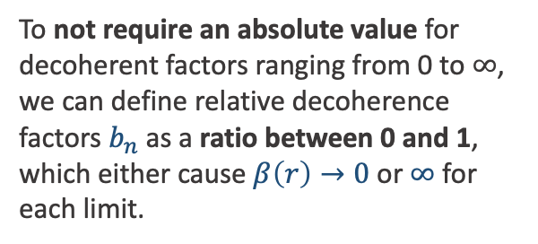
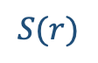
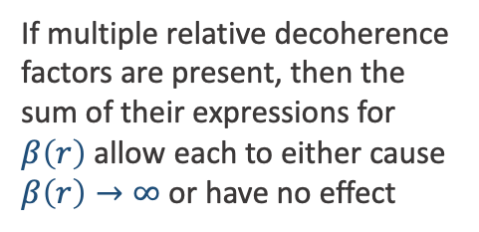
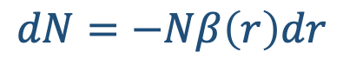

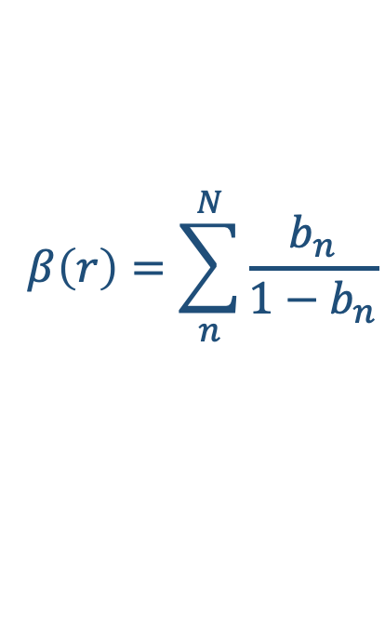
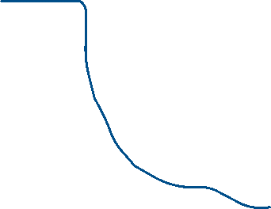
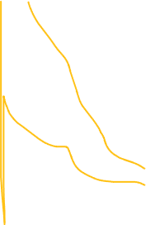
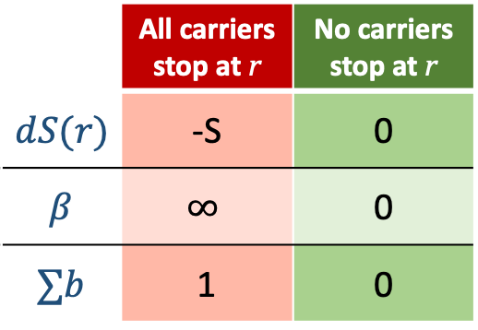
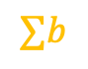
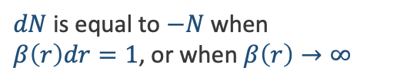
$λ\text{—}$Structural Coherence Length
Scaling Contributions to Decoherence
$$dN=−Nβ\left(r\right)dr$$
$dN$ is equal to $−N$ when
$β\left(r\right)dr=1$, or when $β\left(r\right)→∞$
$$β$$
$$S(r)$$
1
$$β\left(r\right)=\sum_{n}^{N}{\frac{b_{n}}{1−b_{n}}}$$
To not require an absolute value for decoherent factors ranging from 0 to ∞, we can define relative decoherence factors $b_{n}$as a ratio between 0 and 1, which either cause $β\left(r\right)→0$ or $∞$ for each limit.
 | All carriers stop at r | No carriers stop at r
$$dS(r)$$ | -S | 0
$$β$$ | $$∞$$ | 0
$$∑b$$ | 1 | 0
If multiple relative decoherence factors are present, then the sum of their expressions for $β\left(r\right)$ allow each to either cause $β\left(r\right)→∞$ or have no effect
$$∑b$$
r

Slide 16
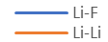
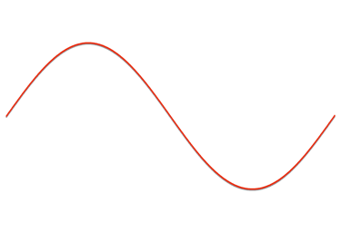
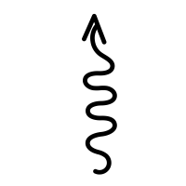

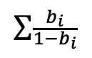
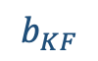
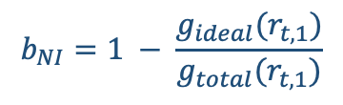
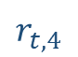
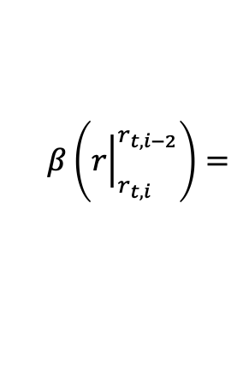
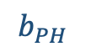
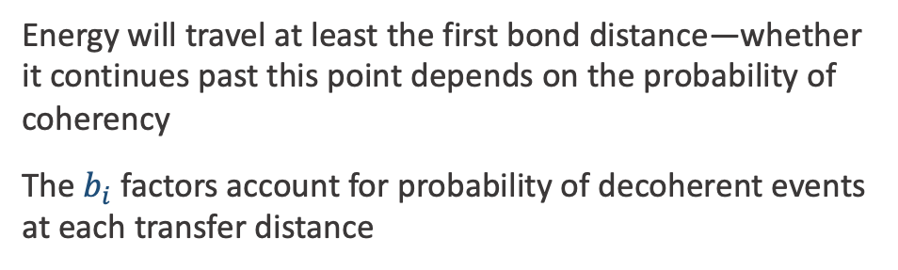
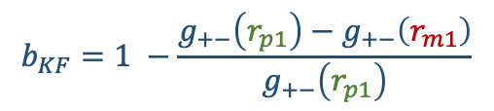
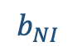
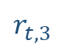

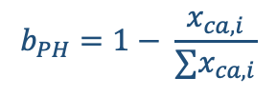










$λ\text{—}$Structural Coherence Length
$$β\left({\left.r\right|}_{r_{t,i}}^{r_{t,i−2}}\right)=$$
$$∑\frac{b_{i}}{1−b_{i}}$$
Disruption Function $β\left(r\right)$
$$b_{NI}$$
$$b_{NI}$$
$$b_{NI}$$
Most efficient separation distance for vibrational energy transfer.
The first peak corresponds to the energy minima, so any other transfer position is assumed to be decoherent
$$b_{KF}$$
$$b_{KF}$$
$$b_{KF}$$
$$…$$
Disruption factors $b_{i}$:
$b_{NI}$: Non-ideal recipient probability factor
$b_{KF}$: Bond strength factor
$b_{PH}$: Phonon transfer factor
$$b_{PH}$$
$$b_{PH}$$
$$b_{PH}$$
$$b_{NI}=1 − \frac{g_{ideal}(r_{t,1})}{g_{total}(r_{t,1})}$$
$$r_{t,1}$$
$$r_{t,2}$$
$$r_{t,3}$$
$$r_{t,4}$$
$$b_{KF}=1 −\frac{g_{+−}\left(r_{p1}\right)−g_{+−}\left(r_{m1}\right)}{g_{+−}\left(r_{p1}\right)}$$
cation- anion- cation- anion
$$b_{PH}=1− \frac{x_{ca,i}}{∑x_{ca,i}}$$
-
-
+
+
+
Energy will travel at least the first bond distance—whether it continues past this point depends on the probability of coherency
The $b_{i}$ factors account for probability of decoherent events at each transfer distance
-
+
Different sized cation
+

Slide 17






$λ\text{—}$Structural Coherence Length
Disruption Function $β\left(r\right)$
$$β\left(r\right)=\sum_{n}^{N}{\frac{b_{n}}{1−b_{n}}}$$
Summary:
Ideal coherence starts at an infinite chain of cation-anion-etc.
Perturbations from ideality drop the structural coherence length according to probabilities of non-coherence factors
The minimum path length is the transfer distance between the first cation-anion pair.
$$S(r)=e^{−\int_{0}^{r}{β\left(r^{′}\right)dr^{′}}}$$
$$λ=\int_{0}^{r_{∞}}{S(r)dr}$$
$$\overline{λ}=\sum_{i}^{N}{x_{i}λ_{i}}$$
$$κ=\frac{1}{3}c_{p,vol}vλ$$
Further development will weight specific heat, speed of sound to estimate each ion pair’s relative contributions

Slide 18
Results

Slide 19

Comparing Predicted $k$

Slide 20

Results
Comparison to Experimental Data

Slide 21

Comparing Predicted $λ$

Slide 22





Results
Compared to Back-Calculated $λ$
FLiBe
$$λ_{BC}=3\frac{k_{exp}}{c_{p,vol}v}$$
Analysis:
13 alkali/alkaline-earth halide salts were analyzed using experimental k and MD simulation PDF data from various literature sources.
Back-calculated structural coherence length provided initial comparisons to present model predictions
$$λ_{BC}=1.92$$
$$λ_{predict}=2.08$$

Slide 23


Results
NaCl-UCl₃
LiCl
Further development will weight specific heat, speed of sound to estimate each ion pair’s relative contributions

Slide 24

Underestimation in Divalent Salt Mixtures
0.535NaCl-0.315MgCl2-0.15CaCl2
In mixtures with MgCl₂, the model consistently underpredicts the SCL
There are two current theories for why this may be:
The salt experiences a “fast sound” as described in F. Demmel’s paper^{[26]}
The MgCl₂ has a unique cation network that allows better phonon transfer between cation-anion pairs
To determine which, mixture salts need to be tested for “fast sound”

Slide 25

Underestimation in Divalent Salt Mixtures
0.345NaF-0.065MgF2-0.59KF
Similar underestimation occurs with mixtures containing MgF₂

Slide 26

Unary Salt Mixtures
MgCl2
Unary MgCl2 not underestimated due to increased “phonon” transfer factor in unary salts—if there are cation-cation chains, the effective mean free path appears to be within that predicted using the phonon transfer factor.

Slide 27
Comparing PDF-based model

Slide 28



Results
Model Comparison
The present model performs comparably well with Gheribi’s kinetic theory for unary and mixture salts.
And the model better predicts actinide-bearing mixtures.
NaCl-UCl₃
When no mixture data was available, the models used fundamental mixing rules for c_{p}, v, and density of the mixture.
NaCl
FLiNaK
“Mix Data” indicates models used the same measured values for speed of sound, specific heat, and density of the mixture

Slide 29
Results
+15%
Model Comparison
-15%
The present model better approximates actinide-bearing salt measurement data than kinetic theory.
Results support possible connection between bulk thermophysical properties and energy carrier properties.
29

Slide 30
Conclusions

Slide 31


2 transverse phonon modes (generally negligible in liquids, high Frenkel frequency)
Properties—Macro to Micro
1 longitudinal phonon mode
Characterizing Energy Carriers
$$κ=\int_{0}^{ω_{Dl}}{\frac{1}{3}c_{l}\left(ω\right)v_{l}\left(ω\right)λ\left(ω\right)dω+\int_{ω_{F}}^{ω_{Dt}}{\frac{2}{3}c_{t}\left(ω\right)v_{t}\left(ω\right)λ\left(ω\right)dω }}$$
What temperature and composition-dependent, measurable parameters characterize the dominant energy carriers?
$$κ=\frac{1}{3}c_{p,vol}vλ$$
Assuming effective properties of energy carriers, neglecting transverse modes
 | Specific Heat Capacity – $c_{p,vol}(T)$ | Group Velocity – $v(T)$ | Mean Free Path - $λ(T)$
Metric | Measured bulk volumetric specific heat | Measured adiabatic speed of sound | Structural coherence length
Reasoning | Successful heat capacity model links phonon states to liquid characteristics^{[18]}. | The macroscopic limit of longitudinal modes give rise to the adiabatic sound velocity^{[21]} | Short-range vibrational modes are dominant energy transfer medium^{[24]}—the average structural coherence length is proportional to short-range order
Questions | Low velocity modes contribute to heat capacity but not thermal conductivity^{[19]}—provides an upper bound^{[20]}. | Molten salts do support shear modes and faster group velocities at very small wavelengths corresponding to interatomic distances^{[22,23]}, but dampen quickly and not dominant^{[20]}. | How do we obtain the effective structural coherence length? How is the coherence of energy transfer affected by structure and liquid diffusion?
 | Populations of transverse modes appear to be very small in proportion to longitudinal modes; these may be considered negligible^{[21]}
$$λ=\int_{0}^{r_{∞}}{S(r)dr}$$
$$\overline{λ}=\sum_{i}^{N}{x_{i}λ_{i}}$$

Slide 32

Conclusions
Successes
Limitations
Present model makes direct connection between molten salt structure and MFP using the PDF
Quantifies disruption factors relative to absolute limits, with no adjustable terms
In preliminary analysis, predictions approximate measured values for both unary salts and mixtures, including actinides
Requires partial PDF of the mixture to predict thermal conductivity
Disruption factors, $b_{n}$, may have nonlinear effects
Limited by accuracy of PDF and mixing rules for specific heat and sound velocity

Slide 33
Future Work

Slide 34

Future work
Further Developments to Implement
Data Needed
Because each cation-anion pair i contribute variably to c_{p} and v_{s}, the total thermal conductivity should be a weighted sum of each pair’s effective contribution.
Weighting these contributions should increase prediction accuracy
Only a limited number of salts were analyzed; more rigorous development will need:
PDFs for all halide unary salts, particularly unary actinide salts
PDFs for key actinide mixtures
Thermal conductivity measurements for more actinide bearing salt mixtures
Compositional studies around the eutectic point will point to trends between composition and k
$$k=\frac{1}{3}\sum_{i}^{N}{c_{p,i}v_{i}λ_{i}}$$

Slide 35


Acknowledgements
Funding for this research has come from the DOE NEUP: Award #DE-NE0009502.
Tony Birri and Nicholas Termini are supported by DOE-NE’s MSR Program and the NEAMS Program.
Meaningful discussions with Benjamin Frandsen and Matthew Asplund also provided valuable direction for the project.
The authors are also grateful for the assistance of Britton Baltich, Isaac Cutler, and Lizzy Robinson in compiling and interpreting data for this work.

Slide 36
Thank You

Slide 37
References from Presentation
[1] Nunes, V. M. B., M. J. V. Lourenço, F. J. V. Santos, M. L. S. M. Lopes, and C. A. Nieto de Castro. “Accurate Measurement of Physicochemical Properties on Ionic Liquids and Molten Salts.” In Molten Salts and Ionic Liquids, 229–63. John Wiley & Sons, Ltd, 2010. https://doi.org/10.1002/9780470947777.ch17
[2] Smith, A.L., 2022. Structure-property relationships in actinide containing molten salts – A review: Understanding and modelling the chemistry of nuclear fuel salts. Journal of Molecular Liquids 360, 119426. https://doi.org/10.1016/j.molliq.2022.119426
[3] Creasman, S., 2023. Sensitivity Analysis of Thermophysical Properties of Molten Salts using a Molten Salt Demonstration Reactor Model in TRANSFORM. Doctoral Dissertations.
[4] Magnusson, J., Memmott, M., Munro, T., 2020. Review of thermophysical property methods applied to fueled and un-fueled molten salts. Annals of Nuclear Energy 146, 107608. https://doi.org/10.1016/j.anucene.2020.107608
[5] Oak Ridge National Laboratory, U. of South Carolina, T. Besman, N. D. B. Ezell, T. Birri, N. Termini, S. Henderson, and J. Schorne-Pinto. (2024) Molten salt thermal properties database. [Online]. Available: https://mstdb.ornl.gov/
[6] Turnbull, A.G., 1961. THE THERMAL CONDUCTIVITY OF MOLTEN SALTS. II. THEORY AND RESULTS FOR PURE SALTS. Australian J. Appl. Sci. Vol: 12.
[7] Cahill, David G., S. K. Watson, and R. O. Pohl. “Lower Limit to the Thermal Conductivity of Disordered Crystals.” Physical Review B 46, no. 10 (September 1, 1992): 6131–40. https://doi.org/10.1103/PhysRevB.46.6131.
[8] Gheribi, A.E., A.T. Phan, and P. Chartrand. “A Theoretical Framework for Reliable Predictions of Thermal Conductivity of Multicomponent Molten Salt Mixtures: KCl-NaCl-MgCl2 as a Case Study.” Solar Energy Materials and Solar Cells 236 (2022). https://doi.org/10.1016/j.solmat.2021.111478.
[9] Gheribi, Aïmen E., and Patrice Chartrand. “Thermal Conductivity of Molten Salt Mixtures: Theoretical Model Supported by Equilibrium Molecular Dynamics Simulations.” The Journal of Chemical Physics 144, no. 8 (February 26, 2016): 084506. https://doi.org/10.1063/1.4942197.
[10] Gheribi, Aïmen E., Jesus A. Torres, and Patrice Chartrand. “Recommended Values for the Thermal Conductivity of Molten Salts between the Melting and Boiling Points.” Solar Energy Materials and Solar Cells 126 (July 1, 2014): 11–25. https://doi.org/10.1016/j.solmat.2014.03.028.
[11] Kincaid, John F., and Henry Eyring. “Free Volumes and Free Angle Ratios of Molecules in Liquids.” The Journal of Chemical Physics 6, no. 10 (October 1, 1938): 620–29. https://doi.org/10.1063/1.1750134.
[12] Nagasaka, Y., and A. Nagashima. “Corresponding States Correlation for the Thermal Conductivity of Molten Alkali Halides.” International Journal of Thermophysics 14, no. 4 (July 1, 1993): 923–36. https://doi.org/10.1007/BF00502115.
[13] Yang, Huiqiang, Ryan Gallagher, Patrice Chartrand, and Aïmen E. Gheribi. “Development of a Molten Salt Thermal Conductivity Model and Database for Advanced Energy Systems.” Solar Energy 256 (May 15, 2023): 158–78. https://doi.org/10.1016/j.solener.2023.04.009.
[14] Zhao, Andrew Z., Matthew C. Wingert, Renkun Chen, and Javier E. Garay. “Phonon Gas Model for Thermal Conductivity of Dense, Strongly Interacting Liquids.” Journal of Applied Physics 129, no. 23 (June 21, 2021). https://doi.org/10.1063/5.0040734.
[15] Landau, Lev Davidovich, and Evgeny Mikhailovich Lifshitz. Course of Theoretical Physics. Vol. 5, Statistical Physics, Part 1. Pergamon Press, 1970.
[16] Trachenko, K., 2023. Theory of Liquids: From Excitations to Thermodynamics. Cambridge University Press, Cambridge. https://doi.org/10.1017/9781009355483
[17] Frenkel, J., 1946. Kinetic theory of liquids, International series of monographs on physics. Clarendon Press, Oxford.
[18] K. Trachenko, “Heat capacity of liquids: An approach from the solid phase,” Phys. Rev. B, vol. 78, no. 10, p. 104201, Sep. 2008, doi: 10.1103/PhysRevB.78.104201.
[19] D. G. Cahill, S. K. Watson, and R. O. Pohl, “Lower limit to the thermal conductivity of disordered crystals,” Phys. Rev. B, vol. 46, no. 10, pp. 6131–6140, Sep. 1992, doi: 10.1103/PhysRevB.46.6131.
[20] Chen, G., 2005. Nanoscale Energy Transport and Conversion: A Parallel Treatment of Electrons, Molecules, Phonons, and Photons. Oxford University Press.
[21] A. Z. Zhao, M. C. Wingert, R. Chen, and J. E. Garay, “Phonon gas model for thermal conductivity of dense, strongly interacting liquids,” Journal of Applied Physics, vol. 129, no. 23, Jun. 2021, doi: 10.1063/5.0040734.
[22] K. Trachenko, Theory of Liquids: From Excitations to Thermodynamics. Cambridge: Cambridge University Press, 2023. doi: 10.1017/9781009355483.
[23] F. Demmel, S. Hosokawa, and W. C. Pilgrim, “Collective particle motions in molten KCl,” Journal of Alloys and Compounds, vol. 452, no. 1, pp. 143–148, Mar. 2008, doi: 10.1016/j.jallcom.2006.10.167.
[24] K. Cornwell, “The thermal conductivity of molten salts,” J. Phys. D: Appl. Phys., vol. 4, no. 3, p. 441, Mar. 1971, doi: 10.1088/0022-3727/4/3/313.
[25] Frandsen, B.A., Nickerson, S.D., Clark, A.D., Solano, A., Baral, R., Williams, J., Neuefeind, J., Memmott, M., 2020. The structure of molten FLiNaK. Journal of Nuclear Materials 537, 152219. https://doi.org/10.1016/j.jnucmat.2020.152219
[26] F. Demmel, S. Hosokawa, and W. C. Pilgrim, “Collective particle motions in molten KCl,” Journal of Alloys and Compounds, vol. 452, no. 1, pp. 143–148, Mar. 2008, https://doi: 10.1016/j.jallcom.2006.10.167.

Slide 38
References for Plot Data
M.-M. Walz and D. van der Spoel. “Molten Alkali Halides: Temperature Dependence of Structure, Dynamics and Thermodynamics.” Physical Chemistry Chemical Physics 21, no. 31 (2019): 17252–17264.
R. L. McGreevy. “Experimental Studies of the Structure and Dynamics of Molten Alkali and Alkaline Earth Halides.” In Solid State Physics, edited by H. Ehrenreich and D. Turnbull, vol. 40, 247–325. New York: Academic Press, 1987.
S. Tahara, H. Toyama, H. Shimakura, and T. Fukami. “Structural Analysis of Molten NaNO₃ by Molecular Dynamics Simulation.” EPJ Web of Conferences 151 (2017): 01004.
J. Sun, H. Huang, H. Wu, Y. Lin, C. Yang, M. Ge, Y. Qian, X. Fu, and H. Liu. “HT-NMR Studies of the Be–F Coordination Structure in FNaBe and FLiBe Mixed Salts.” JACS Au 4, no. 6 (June 2024): 2211–2219.
S. Fayfar, R. Chahal, H. Williams, D. N. Gardner, G. Zheng, D. Sprouster, J. Neuefeind, D. Olds, A. Hwang, J. McFarlane, R. C. Gallagher, M. Asta, S. Lam, R. O. Scarlat, and B. Khaykovich. “Revealing the Complex Structure of Molten FLiBe (2LiF–BeF₂) by Experimental X-ray Scattering, Neutron Scattering, and Deep Neural Network-Based Molecular Dynamics.” (July 2023).
B. A. Frandsen, S. D. Nickerson, A. D. Clark, A. Solano, R. Baral, J. Williams, J. Neuefeind, and M. Memmott. “The Structure of Molten FLiNaK.” Journal of Nuclear Materials 537 (August 2020): 152219.
V. F. Grizzi, S.-C. Lee, and Y. Z. “First-Principles Investigation of the Effects of UF₄ and ThF₄ Fuels on the Structural, Dynamic, and Thermodynamic Properties of LiF–NaF.” The Journal of Physical Chemistry B 128, no. 23 (June 2024): 5676–5684.
A. R. Solano, A. Clark, K. P. Detrick, M. J. Memmott, and S. D. Nickerson. “Characterization of the Molten Salt FMgNaK through Ab Initio Molecular Dynamics and Experimental Density Measurements.” Journal of Nuclear Materials 557 (December 2021): 153248.
Golyshev, Vladimir D. “Experimental Investigation of the Thermal-Conductivity of Transparent Melts”, TVT, 21:5 (1983), 899–903; High Temperature, 21:5 (1983), 684–687,” 1983. https://www.mathnet.ru/php/archive.phtml?wshow=paper&jrnid=tvt&paperid=6160&option_lang=eng.
Golyshev, Vladimir D. “High-Temperature Thermophysical Properties of Nonscattering Semitransparent Materials I: Methods and Instrumentation for the Determination of Spectral Absorptivity and Thermal Conductivity of Melts,” no. 4 (1992): 367–77.
Khlebnikov, O. E., V. A. Sokolov, I. E. Veneraki, and A. N. Alabovsky. “Determination of Thermal Conductivity Coefficients of Lithium, Magnesium, Calcium, and Barium Fluorides in the Liquid State.” Thermophysical Properties of Substances 5 (1981): 97–101.
Harada, Makoto, Akihisa Shioi, Tsunetoshi Miura, and Shinsuke Okumi. “Thermal Conductivities of Molten Alkali Metal Halides.” Industrial & Engineering Chemistry Research 31, no. 10 (October 1, 1992): 2400–2407. https://doi.org/10.1021/ie00010a021.
Nagasaka, Y., and A. Nagashima. “Measurement of the Thermal Diffusivity of Molten KCl up to 1000°C by the Forced Rayleigh Scattering Method.” International Journal of Thermophysics 9, no. 6 (November 1, 1988): 923–31. https://doi.org/10.1007/BF01133260.
Gheribi, Aïmen E., Jesus A. Torres, and Patrice Chartrand. “Recommended Values for the Thermal Conductivity of Molten Salts between the Melting and Boiling Points.” Solar Energy Materials and Solar Cells 126 (July 1, 2014): 11–25. https://doi.org/10.1016/j.solmat.2014.03.028.
Khokhlov, V., I. Korzun, V. Dokutovich, and E. Filatov. “Heat Capacity and Thermal Conductivity of Molten Ternary Lithium, Sodium, Potassium, and Zirconium Fluorides Mixtures.” Journal of Nuclear Materials 410, no. 1 (March 1, 2011): 32–38. https://doi.org/10.1016/j.jnucmat.2010.12.306.
Merritt, Brian, Michael Seneca, Ben Wright, Noah Cahill, Noah Petersen, Austin Fleming, and Troy Munro. “Thermal Conductivity Characterization of Fluoride and Chloride Molten Salts Using a Modified Transient Hot-Wire Needle Probe.” International Journal of Thermophysics 43, no. 10 (August 10, 2022): 149. https://doi.org/10.1007/s10765-022-03073-2.
Nagasaka, Y., N. Nakazawa, and A. Nagashima. “Experimental Determination of the Thermal Diffusivity of Molten Alkali Halides by the Forced Rayleigh Scattering Method. I. Molten LiCl, NaCl, KCl, RbCl, and CsCl.” International Journal of Thermophysics 13, no. 4 (July 1, 1992): 555–74. https://doi.org/10.1007/BF00501941.
Robertson, Sean G., Ralph Wiser, Wonseok Yang, Dokyu Kang, Sungyeol Choi, Emilio Baglietto, and Michael P. Short. “The Curious Temperature Dependence of Fluoride Molten Salt Thermal Conductivity.” Journal of Applied Physics 131, no. 22 (June 8, 2022): 225102. https://doi.org/10.1063/5.0088059.
Rudenko, Alexey, Alexander Redkin, Evgeniya Il’ina, Svetlana Pershina, Peter Mushnikov, Yuriy Zaikov, Sergey Kumkov, Yalan Liu, and Weiqun Shi. “Thermal Conductivity of FLiNaK in a Molten State.” Materials 15, no. 16 (January 2022): 5603. https://doi.org/10.3390/ma15165603.
Smirnov, M. V., V. A. Khokhlov, and E. S. Filatov. “Thermal Conductivity of Molten Alkali Halides and Their Mixtures.” Electrochimica Acta 32, no. 7 (July 1, 1987): 1019–26. https://doi.org/10.1016/0013-4686(87)90027-2.
V. I. Fedorov, V. I. Machuev, “Thermal Conductivity of Fused Salts”, TVT, 8:4 (1970), 912–914; High Temperature, 8:4 (1970), 858–860. Accessed March 23, 2024. https://www.mathnet.ru/php/archive.phtml?wshow=paper&jrnid=tvt&paperid=7779&option_lang=eng.

Slide 39
Extra Slides

Slide 40
Previous Estimation Approaches
Macroscopic
Thermodynamics
 | Liquid Theory |  |  |  |  | Fitting Methods
 | Phonon Gas Model (Zhao, 2021) (PGM) | Kinetic Theory (Gheribi) |  | Bridgman-type | Chapman-Enskog | Corresponding states, semi-empirical models
 |  | 2014 Empirical Fit (KT_{emp}) | 2024 Kinetic Theory (KT₂₄)
Energy Carriers | Phonon modes, approximated by macro-properties | Relates thermal conductivity to ionic radius proportionality by fitting to KCl data (Nagasaka, 1992) | Scales the Cahill-Poll minimum thermal conductivity according to anion complexity | Dilute gas interactions in a cubic lattice, relates λ to variation in free volumes/angles | Energy transfer occurs via collisions, modified with density and viscosity | Underlying thermal behavior follows across states of matter and certain materials
Temperature Dependence | Negative Based on temp-dependent sound velocity and density | Negative Based on thermal expansivity at melting point scaled with temperature change and composition |  | Negative Based on temp-dependent sound velocity and density | Negative Based on temp-dependent viscosity estimation | Matches temp-dependent behavior of fitted data
Limitations | Unknown phonon freq. distribution requires use of thermodynamic properties | Requires fitting to empirical data to scale the phonon mean free path relationship | Increased deviation with highly disparate ion mass (particularly actinides) | Does not consider dissociated interatomic behavior (prevalent in molten salt ions) | Does not capture the temperature dependence of salts. | May not be able to extrapolate for salt and compositional variation.
Molecular Interactions
Microscopic
Notes:
Enter speaker notes here.

Slide 41
Energy Carriers in a Coherent Medium
Simplifying the Liquid Approach
The properties of any interacting system are governed by its excitations—the energy carriers^{[15]}.
Two general principles
1. Heat is transferred by some dominant form of energy carrier(s)
2. These propagate with effective properties while coherent medium
Hot
x+λ
Electrons
Metal
Mean free path before collision (energy transfer)
x=0
Phonons
Perfect crystal
x-λ
Atoms
Empty space
Monatomic, dilute gas
Photons
Transparent Solid
x
Once medium coherence ends (crystal defect, collision between atoms, etc.) the energy carrier transfers its energy to new carrier
Cold
y
z
The spatial and temporal extent of coherence determines mean free path

Slide 42




Energy Carriers in a Coherent Medium
Kinetic Theory of Gases
For a monatomic gas, only 1 dominant energy carriers (atoms) with characteristic:
Heat capacity/particle $∝$ particle kinetic energy ($\frac{{mv}^{2}}{2}$)
Velocity (avg of Maxwellian distribution)
Mean free path between collisions
The heat flux $q$ is the energy crossing a hot-cold gradient surface:
Hot
x+λ
Mean free path before collision (energy transfer)
x=0
$$q=−\frac{1}{3}c_{p}\left\langle v\right\rangle λ\frac{∂T}{∂x}$$
Heat flux $q$ in terms temperature gradient
x-λ
Monatomic, dilute gas
x
$$k=\frac{1}{3}c_{p}\left\langle v\right\rangle λ$$
Thermal conductivity in terms of energy carrier properties
Cold
y
z

Slide 43




Pair Distribution Function
Molten FLiNaK.
a) Experimental PDF
b) Modeled partial PDF ^{[25]}
Short Range Liquid Structure
g(r)
Solid Crystal
The partial PDF gives the probabilities of separation distances for individual ion pairs
Normalized by radial distance, the partial PDF provides the probability $gAB(r)$ of finding an ion B a distance r from reference ion A.
Can the PDF provide information about the mean free path of energy carriers?
1
r
g(r)
Gas
1
r
Liquids lack long-range periodicity of crystal, but have preferential arrangements at short distances.
g(r)
Liquid
1
r

Slide 44






$λ\text{—}$Structural Coherence Length
Coherence Survival Function $S\left(r\right)$
If $N$ energy carriers are emitted from an energized cation over time,
The surviving carriers will decrease by $dN$ over a distance $dr$
This is the probability of transferring energy to non-ideal recipients—
Termed the disruption probability function $β\left(r\right)$.
$$\frac{N_{r}}{N_{0}}=e^{−\int_{r_{0}}^{r}{β\left(r^{′}\right)dr^{′}}}$$
The fraction of energy carriers remaining at a distance $r$
$$S\left(r\right)=\frac{N_{r}}{N_{0}}=e^{−\int_{r_{0}}^{r}{β\left(r^{′}\right)dr^{′}}}$$
Cumulative survival probability function $S\left(r\right)$

Slide 45

$λ\text{—}$Structural Coherence Length
Interpreting the Pair Distribution Function
How does coherence change with distance?
Rules for coherency:
The ideal recipients of energy carriers are oppositely charged ions separated by distance of interaction potential minima (most efficient transfer)
Decoherence results in the transfer of energy to system—new energy carriers
Interacting with a non-ideal recipient breaks coherence. Non-ideal recipients include:
Same-charge ions
Dissimilar next-ions from the originating ion
Out-of-phase transfer

Slide 46







$λ\text{—}$Structural Coherence Length
Disruption Function $β\left(r\right)$
$$r_{t,1}$$
Disruption factors $b_{i}$:
$$r_{t,2}$$
$$r_{t,3}$$
$$r_{t,4}$$
Calculated at discrete transfer radii $r_{t,n}$ because the ideal coherent medium is a sequential chain of cation-anion-cation-anion-etc. Assumes other interaction distances leads to decoherence.
The interval spacing for efficient transfer are given by the first peak distance for each cation-anion pair, corresponding to the energy minima.
Subsequent peaks are not determined by interaction potential with central ion—dictated by packing density
Most efficient separation distance for vibrational energy transfer. The first peak corresponds to the energy minima, so any other transfer position is assumed decoherent

Slide 47







$λ\text{—}$Structural Coherence Length
Coherence Survival Function $S\left(r\right)$
If $N$ energy carriers are emitted from an energized cation over time, the surviving carriers will decrease by $dN$ over a distance $dr$ according to the probability of transferring energy to non-ideal recipients—the disruption probability function $β\left(r\right)$.
The change in the number of energy carriers according to $β\left(r\right)$ over distance $dr$
$$dN=−Nβ\left(r\right)dr$$
$$\int_{N_{0}}^{N_{r}}{\frac{1}{N}dN}=−\int_{r_{0}}^{r}{β\left(r^{′}\right)dr^{′}}$$
Rearranging and solving for the number of energy carriers as a function of radius
$$\frac{N_{r}}{N_{0}}=e^{−\int_{r_{0}}^{r}{β\left(r^{′}\right)dr^{′}}}$$
The fraction of energy carriers remaining at a distance $r$
$$S\left(r\right)=\frac{N_{r}}{N_{0}}=e^{−\int_{r_{0}}^{r}{β\left(r^{′}\right)dr^{′}}}$$
Cumulative survival probability function $S\left(r\right)$

Slide 48
$λ\text{—}$Structural Coherence Length
Disruption Function $β\left(r\right)$
$$β\left(r\right)=\sum_{n}^{N}{\frac{b_{n}}{1−b_{n}}}$$
Summary:
Ideal coherence starts at an infinite chain of cation-anion-etc.
Perturbations from ideality drop the structural coherence length according to probabilities of non-coherence factors
The minimum path length is the transfer distance between the first cation-anion pair.
↑Why the effect of Umklapp scattering, 4-phonon scattering reaches max effect—no T³ temperature dependence.
$$S(r)=e^{−\int_{0}^{r}{β\left(r^{′}\right)dr^{′}}}$$
$$λ=\int_{0}^{r_{∞}}{S(r)dr}$$
$$\overline{λ}=\sum_{i}^{N}{x_{i}λ_{i}}$$
$$κ=\frac{1}{3}c_{p,vol}vλ$$
Further development will weight specific heat, speed of sound to estimate each ion pair’s relative contributions

Slide 49


PDF Dependency
MgCl₂ (1987)
As shown, inaccurate PDF data leads to significant errors in the model’s prediction
This reliance on accurate PDF data, and the difficulty in obtaining it, points to potentially meaningful further development in building a model that can estimate the SCL for salts without PDF data
MgCl₂ (2021)

Slide 50


Homogenous Cation Species Effects
Zhao’s approximation of $\left\langle v\right\rangle$ underestimates compared to experimental data
Determining whether homogenous cation species contribute to “fast sound” or a longer MFP, the model will know whether to weight the $λ$ or $\left\langle v\right\rangle$components of the k equation
Fast sound supports Demmel’s “liquid metal” theory
Longer MFP supports our cation network theory

Slide 51
Summary
Future Work
Understanding physical mechanisms underlying molten salt thermal conductivity will enable increased predictability and MSR optimization
Linking liquid structure to thermophysical properties can provide insights for liquid molecular energy transport theory
Actinide-bearing salts have been successfully predicted, but more experimental and PDF data is needed to validate full extent of model
Upcoming k measurements at BYU of various compositions of NaCl-UCl₃ with respective partial PDFs to observe compositional
Potential to generalize model using endmember PDFs (instead of full mixture) to provide full predictive thermal conductivity model for actinide-bearing salts

